Slide 1
ER Model Example for Educational Institute

Slide 2
Complete Example for E/R schema: Specifications (1/3)
In an educational institute, there are several departments and students belong to one of them. Each department has a unique department number, a name, a location, phone number and is headed by a professor.
Professors have a unique employee Id, name, phone number. We like to keep track of the following details regarding students: name, unique roll number, sex, phone number, date of birth, age and one or more email addresses.

Slide 3
Complete Example for E/R schema: Specifications (2/3)
3. Students have a local address consisting of the hostel name and the room number. They also have home address consisting of house number, street, city and PIN. It is assumed that all students reside in the hostels.
4. A course taught in a semester of the year is called a section. There can be several sections of the same course in a semester; these are identified by the section number. Each section is taught by a different professor and has its own timings and a room to meet.

Slide 4
Complete Example for E/R schema: Specifications (3/3)
5. Students enroll for several sections in a semester. Each course has a name, number of credits and the department that offers it. A course may have other courses as pre-requisites i.e, courses to be completed before it can be enrolled in.
6. Professors also undertake research projects. These are sponsored by funding agencies and have a specific start date, end date and amount of money given. More than one professor can be involved in a project. Also a professor may be simultaneously working on several projects. A project has a unique projectId.

Slide 5
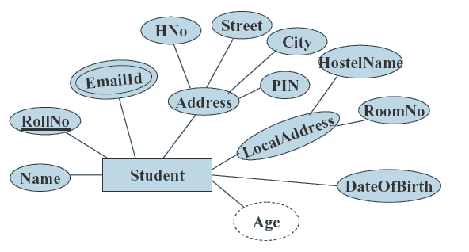
Entities -Student

Slide 6
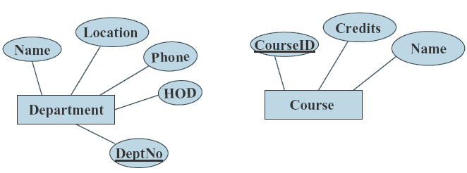
Entities –Department and Course

Slide 7
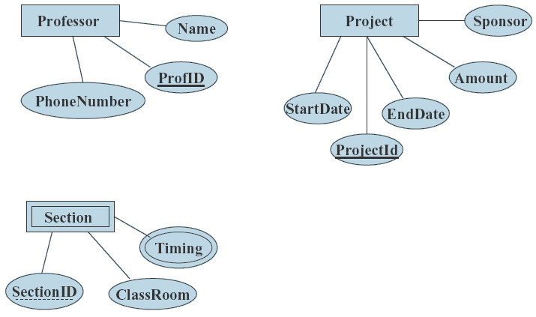
Entities –Professor, Project and Sections

Slide 8
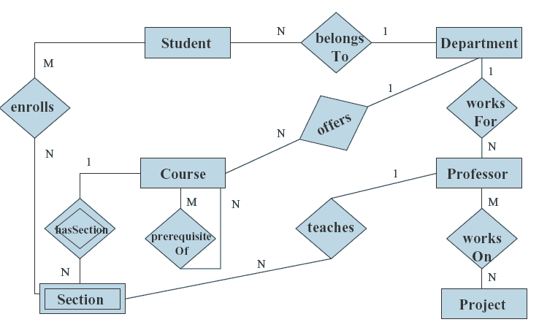
E/R Diagram showing relationships

